Slide 1
USER
By: Kshitiz Srivastava

Slide 2
User
A user is a person having an experience.

Slide 3
You are not the user
Teams unconsciously introduce biases into their work.
Acknowledging bias helps avoid its effects.
Teams are creators of an experience, not the users of it.
Users do not share your concerns about your client, company, or team.

Slide 4


Slide 5
Personas
Personas help to focus product decisions by adding a layer of real-world
They act almost like another person in the room
when making vital product decisions.
However, personas shouldn’t represent all audiences or address all needs of your product but should instead focus on the major needs of the most important user groups.

Slide 6
Personas
Simple steps for creating Personas
Assign a name
Describe job responsibilities
Include vivid information

Slide 7
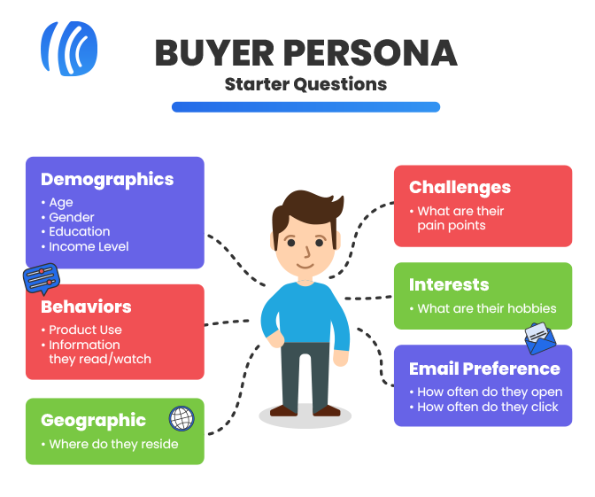

Slide 8
User Stories & Job Stories
Independent — The user story should be self-contained so it doesn’t depend on other stories
Negotiable — Avoid too much detail so user stories are flexible and can be altered
Valuable — User stories must deliver value to the end-user
Estimable — You should be able to estimate the resources needed for a user story

Slide 9
User Stories & Job Stories
Scalable — Keep the user stories lightweight so they can be tasked and prioritized with a certain level of certainty
Testable — Explain the acceptance criteria so the team knows when a story is complete

Slide 10
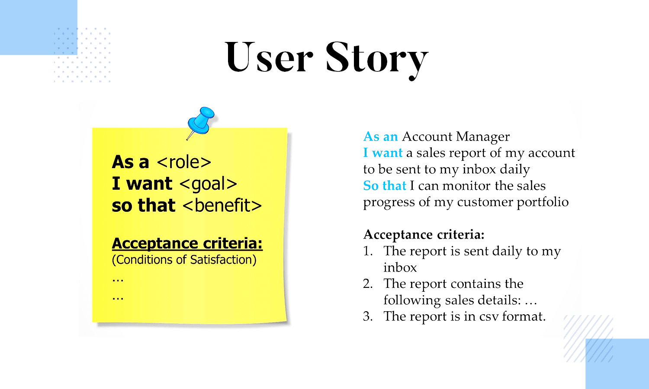

Slide 11
Keep It Simple
Complex designs are difficult to build and maintain.
Other products and services compete for your users’ time and attentions.
Unnecessary features distract users away from necessary features.
Provide users a default solution and allow users to edit it as needed.
Good UX is more than a summation of features.

Slide 12
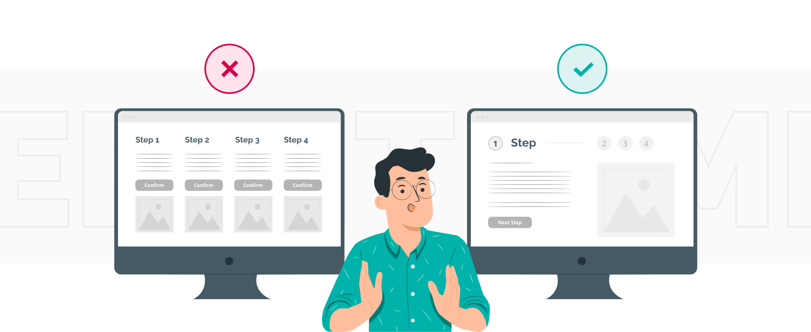

Slide 13
Speak the User’s Language
People use their past experiences to decipher new information.
Users come from diverse backgrounds and may not understand business, marketing, and technology.
UX translates business, marketing, and technology solutions into meaningful experiences for users.
Effective UX fulfills users’ needs.

Slide 14
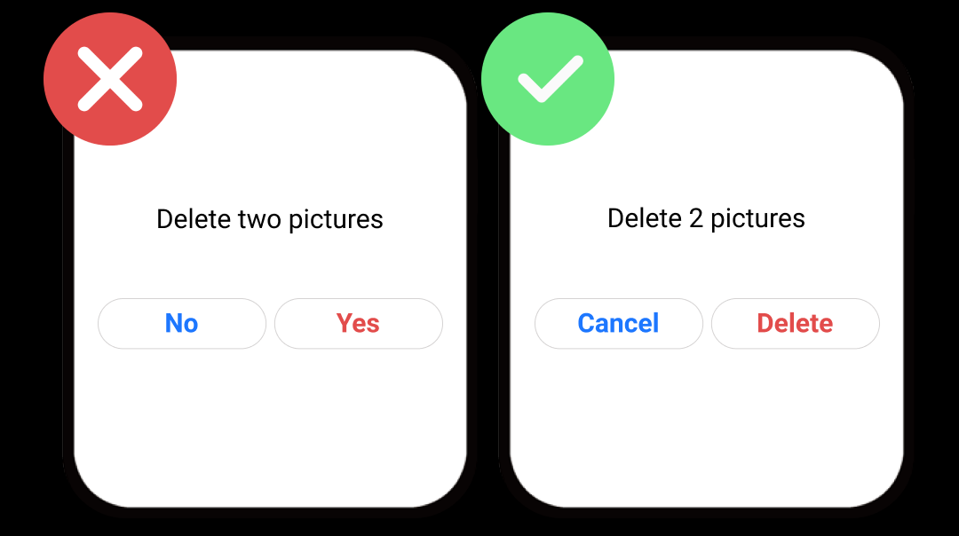

Slide 15
Reducing Cognitive Load
Avoid Unnecessary Elements
Leverage Common Design Patterns
Eliminate Unnecessary Tasks
Minimize Choices
Display Choices as a Group
Strive for Readability
Use Iconography with Caution

Slide 16
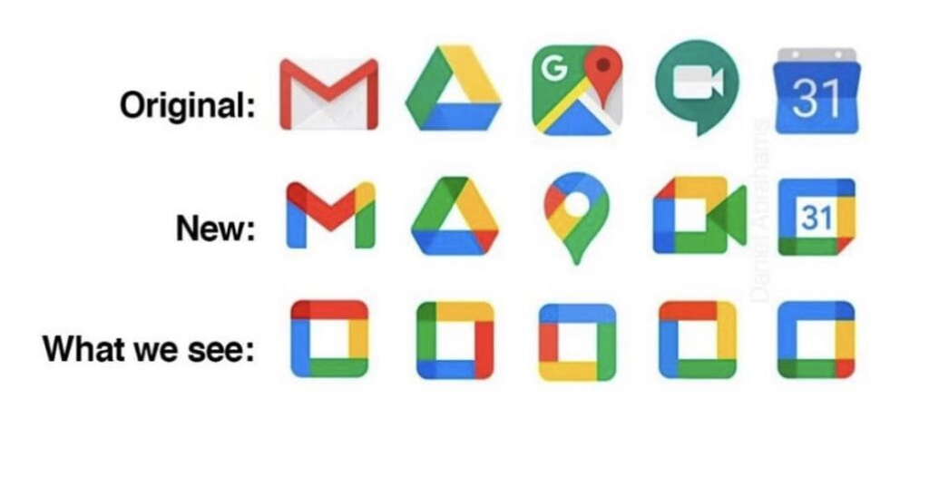

Slide 17
THANKU

